Slide 1
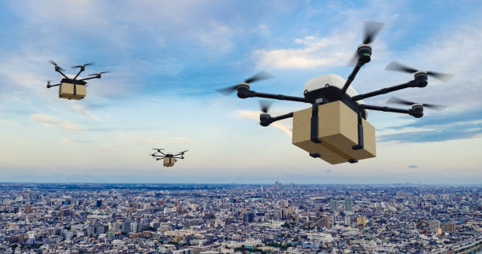
Drone Delivery System

Slide 2
Traditional Delivery System
Delivers the order and ETA
Customer
Delivery Agent
Restaurant details
Place the order
Application
Order details
delivery agent allocation
Food preparation details
Picks the delivery
Restaurant

Slide 3
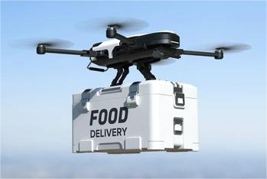
Drone Specification
battery cost 13k
Return to home feature
150-300ft altitude
Flying range
7-8 kms
max capacity
5kg
autonomous flight features
130k per drone
avg speed
40kph
flight time
30min
3D obstacle sensing
navigation visual sensing
maintenance 6.5k per month
3months battery life

Slide 4
Areas of Implementation
Each hub covering a radius of 5 km.
Area of Bangalore = 741 sq.kms
No of hubs = 741/3.14*5*5=9.37 ~ 10
Average monthly orders = 7500000
Average orders in bangalore= 0.24*7500000=1800000
Orders during peak time in bangalore=0.7*1800000=1260000 (monthly) 42000 (per day)
Distribution of orders received by a typical restaurant
Distance <=3 4 5 6
orders 504000 441000 252000 63000
orders(d) 16800 14700 8400 2100
revenue for total orders=1260000*70=88200000
no of delivery boys per month=1260000/500=2520
bonus for all orders=1260000*55=69300000
total monthly salary for delivery boys=2520*4000=10080000
total monthly salary for delivery boy including bonus=10080000+69300000=79380000
Total expense for drones
cost for drone = 130K
cost for battery = 13K
maintenance cost for month = 6.5K
average speed = 40Km/Hr
Avg Battery life = 3 months
flying range = 7-8 Km

Slide 5
Average Monthly orders of existing system
Avg monthly orders for 2022 using straight line trend (time series)
Year | y | x(year-mid year) | x2 | xy
2017 | 2000000 | -2 | 4 | -4000000
2018 | 2500000 | -1 | 1 | -2500000
2019 | 3000000 | 0 | 0 | 0
2020 | 5200000 | 1 | 1 | 5200000
2021 | 7600000 | 2 | 4 | 15200000
Total | 20300000 | 0 | 10 | 13900000

Slide 6
Revenue per order(RPO) of existing system
RPO for the last 5 years is as follows
Year | RPO(Rs) | Annual growth rate(%)
2017 | 52 | 19.23
2018 | 62 | 3.23
2019 | 64 | 1.56
2020 | 65 | 7.69
2021 | 70 | 7.18
2022 | ? | ?
Revenue per order in 2022 = 70*(1+7.18%) = 75.026

Slide 7
Orders and Revenue per Drone
Orders and revenue per drone
No of orders received by cust to rest | 40% | 35% | 20% | 5%
Distance from rest to cust home | 1 | 2 | 3 | 4 | 5 | 6
dist from hub to rest | 3 | 3 | 3 | 3 | 3 | 3
dist from cust to nearest hub | 3 | 3 | 3 | 3 | 3 | 3
dist covered by drone in 1 del | 7 | 8 | 9 | 10 | 11 | 12
flight time 30 min | 30 | 30 | 30 | 30 | 30 | 30
average speed kmph | 40 | 40 | 40 | 40 | 40 | 40
time taken to deliver order | 10.5 | 12 | 13.5 | 15 | 16.5 | 18
max orders drone can deliver in 30m | 2 | 2 | 2 | 2 | 1 | 1
no of delivers in 60m | 4 | 4 | 4 | 4 | 2 | 2
no of deliveries per day | 24 | 24 | 24 | 24 | 12 | 12
no of deliveries per week | 168 | 168 | 168 | 168 | 84 | 84
no of deliveries per month | 672 | 672 | 672 | 672 | 336 | 336
no of deliveries per year | 8064 | 8064 | 8064 | 8064 | 4032 | 4032
revenue per order | 70 | 70 | 70 | 70 | 70 | 70
revenue per day | 1680 | 1680 | 1680 | 1680 | 840 | 840
revenue per week | 11760 | 11760 | 11760 | 11760 | 5880 | 5880
revenue per month | 47040 | 47040 | 47040 | 47040 | 23520 | 23520
revenue per year | 564480 | 564480 | 564480 | 564480 | 282240 | 282240

Slide 8
Distribution Order received per drone
Distribution of orders | 40% | 35% | 20% | 5%
Monthly Orders | 672 | 672 | 336 | 336
Total orders(considering dis of orders) | 633
Total Revenue | 44310

Slide 9
Orders and Revenue per Hub
Orders and Revenue per hub
No of drones | 8
No of orders received by each cx to rest | 40% | 35% | 20% | 5%
Dist from rest to cust home | 11 | 2 | 3 | 4 | 5 | 6
no of deliveries per day | 192 | 192 | 192 | 192 | 96 | 96
no of deliveries per month | 5376 | 5376 | 5376 | 5376 | 2688 | 2688
no of deliveries per year | 64512 | 64512 | 64512 | 64512 | 32256 | 32256
revenue per month | 376320 | 376320 | 376320 | 376320 | 188160 | 188160
revenue per year | 4515840 | 4515840 | 4515840 | 4515840 | 2257920 | 2257920

Slide 10
Orders and Revenue from all hubs
Orders and Revenue for Total hubs (10)
Number of hubs | 10
Number of orders received by each cust to rest | 40% | 35% | 20% | 5%
Distance from restaurant to customer home | 1 | 2 | 3 | 4 | 5 | 6
No of deliveries per day | 1920 | 1920 | 1920 | 1920 | 960 | 960
No of deliveries per month | 53760 | 53760 | 53760 | 53760 | 26880 | 26880
No of deliveries per year | 645120 | 645120 | 645120 | 645120 | 322560 | 322560
Revenue per month | 3763200 | 3763200 | 3763200 | 3763200 | 1881600 | 1881600
Revenue per Year | 45158400 | 45158400 | 45158400 | 45158400 | 22579200 | 22579200

Slide 11
Comparison of operational cost for both the system
Operational cost for current system
Operational cost for drone delivery system
Avg Orders (per month by 1 delivery executive) | 425
Avg orders per day | 15
No of orders during peak hrs | 11
Fixed salary(per month) | 4000
Bonus(per order) | 55
total bonus per month | 605
monthly total salary | 4605
yearly total salary | 55260
for total executives | 231539400
profit | 1030119600
profit per month | 34337320
Total number of drones required | 80
Total number of batteries required | 320
Hub Setup(10 hubs) | 3000000
Master control center | 500000
drone license for master pilot | 1000
for 80 drones | 80000
cost of total drones | 10400000
drone maintenance cost | 520000
drone maintenance cost per year | 6240000
total batteries cost | 16640000
salary of per pilot per month | 35000
pilots required | 20
salaries for 20 pilots per month | 700000
salaries for 20 pilots per year | 8400000
hub maintenance per month | 50000
hub maintenance per month 10 hubs | 500000
hub maintenance per year | 6000000
operational cost | 51260000
profit | 1796516000
profit per month | 59883867

